Slide 1
Angular 2-8

Slide 2
What is Angular?
Frontend/ client-side JS framework
Created & maintained by Google
Used to create SPAs (Single Page Applications)
Part of MEAN stack

Slide 3
Angular versions
Angular JS/Angular (Scope and Apps)
Angular 2 (Complete re-write of framework -> Component based)
Angular 4 (Corrected router component, which was out of sync in 2) – Complete backward compatible with Angular 2
Angular 5-8 Many new features like Injectables, SaaS support added

Slide 4
Angular Features
Rapid development& code generation
Code organization
Dynamic content in HTML
Cross platform
Unit Testing

Slide 5
Angular core features
Components
Services
Routing
Data Binding
Templating
TypeScript

Slide 6
TypeScript
Developed by Microsoft
Superset of Javascript, with added features/functionalities
Static typing (Specify types for variables)
Classes – Object-oriented programming

Slide 7
Installations and setting up
Pre-requisite : Node.js
CLI : npm install –g @angular/cli
Check installation : ng --version
Help: ng --help
Set-up project : ng new <project-name>
Start application: ng serve

Slide 8
Components
Logical piece of code for Angular applications
Contains 3 parts:
Template – HTML template for component
Class – Code to support the view. Written in TypeScript
Metadata – Extra data for class. Defined using decorators

Slide 9
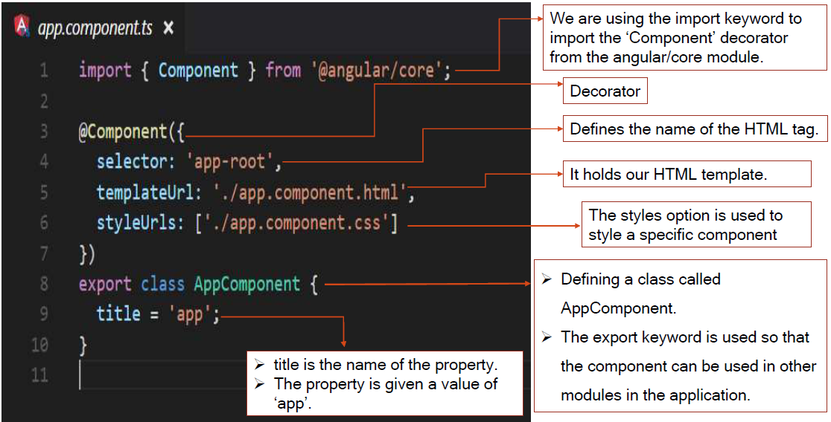
Components

Slide 10
Constructors
constructor() : Class’ constructor. Invoked after class creation
ngOnInit() : Angular lifecycle hook. Invoked after Angular’s component creation is complete

Slide 11
app.module.ts file
Declarations: components in the module
Imports: dependencies in module
Providers: Services consumed by the module
Bootstrap: Defines top-level component for the app

Slide 12
Building app for production
ng build --target=production --base-href ‘/’
base href of ‘/’ defines that the application will be deployed at root level

Slide 13
Component inputs and outputs
Component inputs specify params(data) we expect our component to receive (i/p binding)
@Input decorators are used
Eg : @Input() name: string <my-component [name]=“myName” ></my-component>
Component outputs are used to send events to the outside world from the component(o/p binding)
@Output decorators are used
(output)=“action”
Eg : <button (click)=“doClickAction()”>Click me</button>

